Slide 1
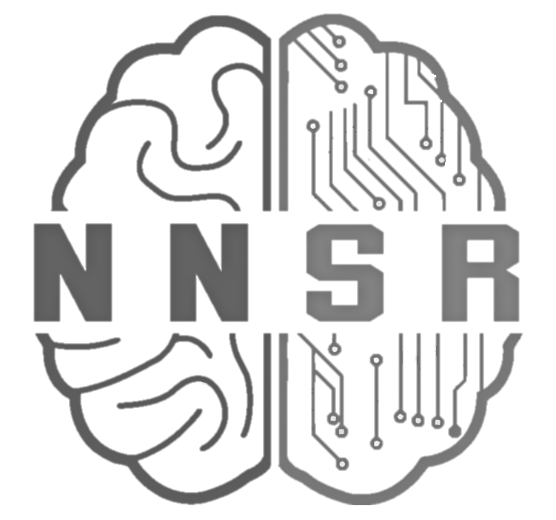
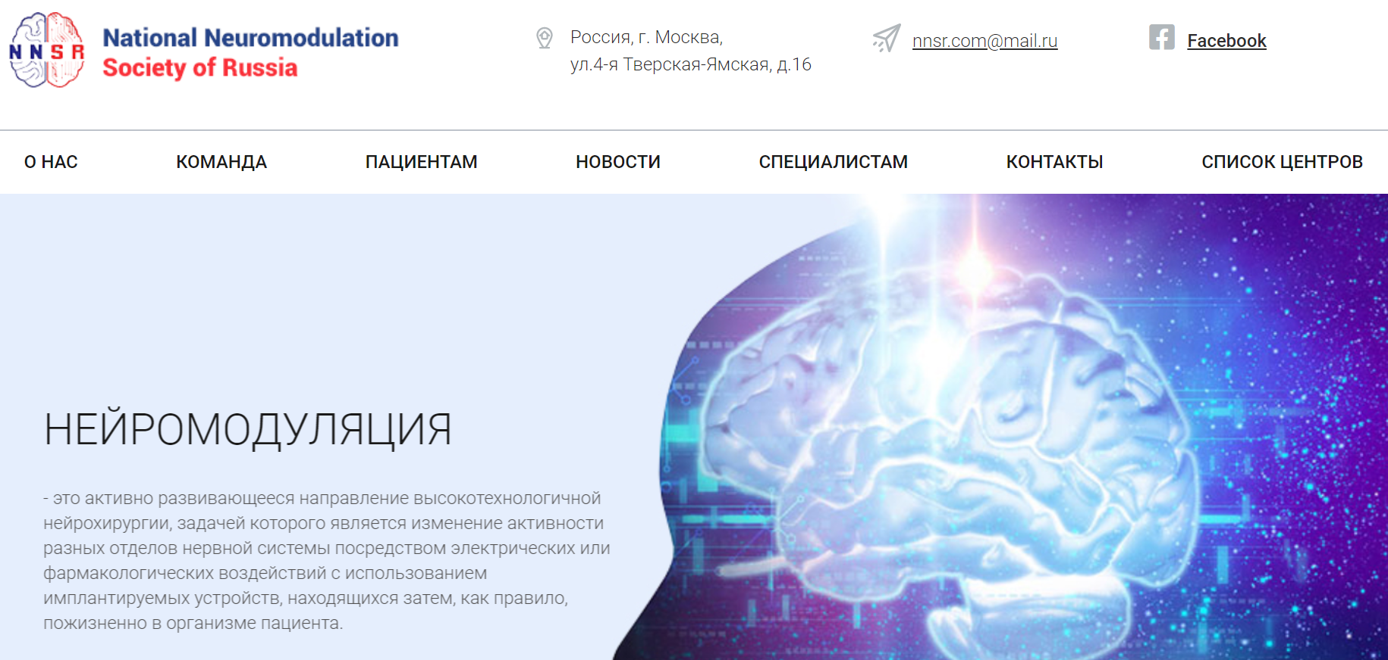
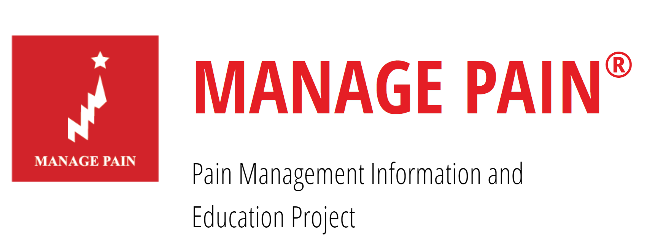
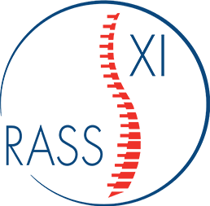
NEWSLETTER
NATIONAL NEUROMODULATION SOCIETY IN RUSSIA
https://nnsr.com.ru
NOVEMBER 2020
Calendar of our events

Slide 2
Membership of the international association
Greater opportunities for learning and experience
Take a part in conferences
Access to scientific data and the possibility of publication
NNSR offers you a mutually profitable cooperation for successful training and professional development. Our members can provides opportunities for internships and carry out scientific research in many countries. The society cooperates: Association of Interventional Treatment of Pain, Russian Society for Functional and Stereotactic Neurosurgery (RSFSN), Russian Association for the Study of Pain, Interdisciplinary Medicine Association (IMA) and others. We all take a part in organization of international conferences and workshops, where everyone of our member can to present their own report.
Registered users can access to selected of scientific literature, to get previews of upcoming events and to participate in our meetings.
By joining the NNSR you become a member the International Neuromodulation Society (INS). INS and NNSR members enjoy the following benefits:
Online and print access to Neuromodulation: Technology at the Neural Interface, the premier journal in the field of neuromodulation, , which is published eight times a year and focuses on all aspects of this growing field;
Members’ web-based resources: journal subscription (including all archived issues), online moderated question-and-answer expert panels, webinars, current explanatory content for healthcare professionals, a global events calendar, daily news briefs, an online discussion capability, public clinic directory and a quarterly newsletter tracking developments around the globe
The possibility of registering to the INS World Congress and Chapter Conferences.
NNSR’s members develop neuromodulation in Russia!
Become a member
https://www.neuromodulation.com/become-a-member

Slide 3
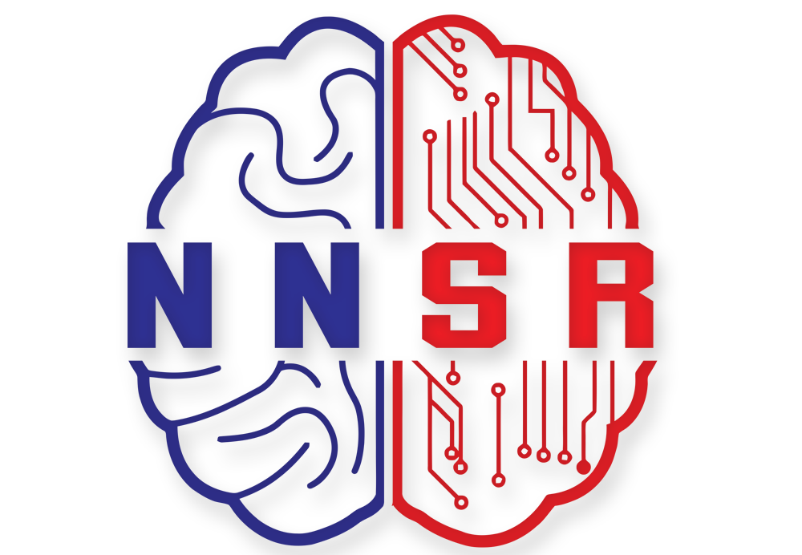
Methods of neuromodulation can help in the most difficult treatment-resistant cases. Nowadays they’ve become a standard of treatment of many chronic pain syndromes, that are applied in Russia and worldwide. There’s a variety of neuromodulation methods, different implantable systems, different anatomical areas of application. Every year there’s new emerging technique. How to navigate the world of neuromodulation today? Which neuromodulation method should be performed and what components and devices should be used in each case?
This monograph will help answer these and many other questions. The book will be of interest, first of all, to neurosurgeons, interventional anesthesiologists, neurologists, neuropsychiatric doctors, general practitioners and everyone who, in one way or another, is faced with the problem of chronic pain syndromes of non-oncological genesis.
FOR MORE INFORMATION AND PRE-ORDER:
https://www.neuromodulationofpain.com/

Slide 4
The Polyanalgesic Consensus Conference (PACC) recommendations
eisagulyan@nsi.ru
President: Isagulyan Emil
Secretary: Makashova Elizaveta
doctorlisa@live.ru

Slide 5
Dear Friends and Colleagues, We would like to invite you to the 2nd Joint Congress of the INS European Chapters (e-INS 2021)!
At e-INS 2021 you will have the opportunity to showcase your latest research, take part in a variety of scientific sessions and discuss the latest advances in Neuromodulation, grow your professional network and enjoy the many relationship-building opportunities our congress will provide. For more information:
https://e-ins.org/
eisagulyan@nsi.ru
President: Isagulyan Emil
Secretary: Makashova Elizaveta
doctorlisa@live.ru

Slide 6
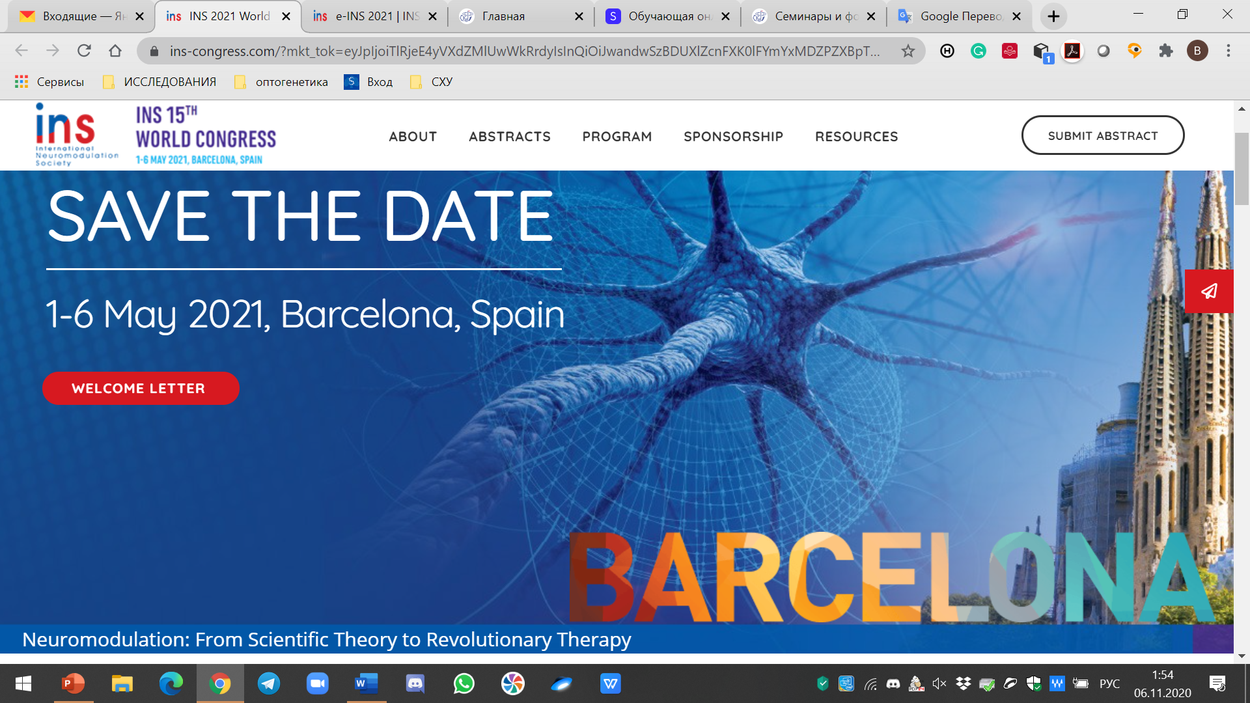
The 2021 congress of the International Neuromodulation Society, themed Neuromodulation: From Scientific Theory to Revolutionary Therapy. A strong theoretical framework has underpinned studies that offer insight into mechanisms of action, and the field has matured into proven therapies delivered with refined and personalized techniques. Plenary sessions from world experts, panel discussions, oral abstract presentations, poster sessions and networking opportunities convey knowledge from multiple disciplines about current practice, future developments, and solutions for neuromodulation therapy of the central, peripheral, and autonomic nervous system. The congress will bring together over 1,500 scientists, researchers, engineers, device developers and healthcare providers from around the globe to share evidence-based knowledge about basic, translational and clinical research; emerging technologies; and global health care trends in order to improve skills, outcomes, and access to patient care. We invite you to join us!
The abstract submission deadline has been extended to
2 December 2020.
https://ins-congress.com/
eisagulyan@nsi.ru
President: Isagulyan Emil
Secretary: Makashova Elizaveta
doctorlisa@live.ru

Slide 7
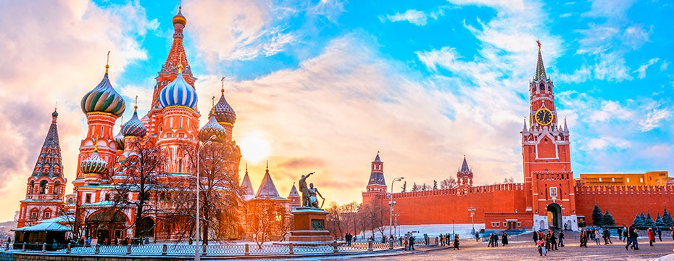
Dear Ladies and Gentlemen
We would like to invite you to the
III INTERNATIONAL CONGRESS AIPM AND
II CONGRESS NNSR
DECEMBER, 09–11, 2020 in MOSCOW
ON-LINE
High-tech methods of treating chronic pain continue to develop in Russia. An increasing number of doctors are using interventional pain management (ultrasound and X-ray navigation). The conference will be attended by leading experts. The program will include the topics of anatomy, pathophysiology and chronic pain, the effectiveness and safety of minimally invasive methods, issues of organization and legal aspects of pain treatment centers.
The third congress will be held training course - a master class in interventional treatment with ultrasound navigation and neuro-orthopedic examination.
For more information:
https://scaf-spb.ru/
eisagulyan@nsi.ru
President: Isagulyan Emil
Secretary: Makashova Elizaveta
doctorlisa@live.ru

Slide 8
Dear Ladies and Gentlemen
We would like to invite you to the XI Interdisciplinary International Congress "Manage Pain", which will be held ON-LINE on November 19-21, 2020.
The purpose of the Congress is to spread advanced knowledge on the problem of pain among Russian doctors, improve communication between doctors of various specialties, as well as international exchange of experience in organizing care and treatment of patients suffering from various pain syndromes.
SECTION ABOUT NEUROMODULATION OF PAIN WILL NOVEMBER, 20
For more information:
https://managepain.ru/congress/
eisagulyan@nsi.ru
President: Isagulyan Emil
Secretary: Makashova Elizaveta
doctorlisa@live.ru

Slide 9
Dear Ladies and Gentlemen
We would like to invite you to the
IV Volga Neurological Forum,
Kazan, November 12-13, 2020
online (Webinar)
The conference will be attended by leading Russian and foreign specialists. The program will include the topics of differential diagnosis of motor and cognitive disorders, vertebral neurological and neuromuscular diseases, pain syndromes, modern principles of pharmacotherapy of widespread use of neurological diseases and rehabilitation approaches. All lecturers will share knowledge and experience!
For more information:
http://ivneuroforum2020.tilda.ws/
eisagulyan@nsi.ru
President: Isagulyan Emil
Secretary: Makashova Elizaveta
doctorlisa@live.ru

Slide 10
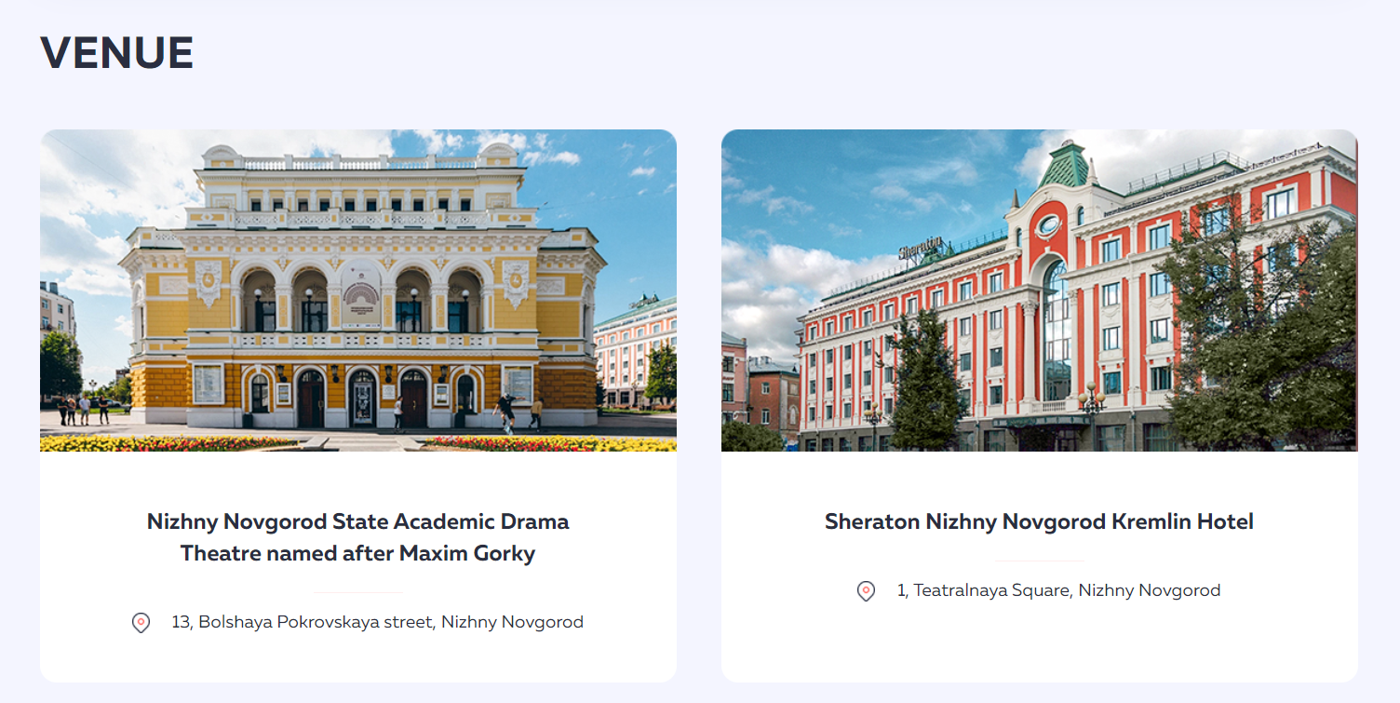
For more information:
https://rass2021.org/
eisagulyan@nsi.ru
President: Isagulyan Emil
Secretary: Makashova Elizaveta
doctorlisa@live.ru

